Slide 1
Form 477 Analysis
Linking Service Provider Information from Form 477 to our districts and schools
May 2017

Slide 2
Goal of Analysis
Form 477 data: All facilities-based broadband service providers file lists of census blocks in which they can or do offer service (of > 200 kbps) to at least one location. The goal is to link this data to districts/schools in our universe so we can understand the overlap between the service providers and districts. Possible applications:
1. CCK12 and district consulting work : Provide a more comprehensive list of service provider options for districts on CCK12 and for district consulting work
2. Developing a ‘marketplace indicator’: Correlate our data about fiber and bandwidth targets and E-rate bids with the Form 477 data to develop a marketplace indicator that evaluates the need and opportunity for deploying broadband to unserved or underserved communities
Current analysis starts to addresses this

Slide 3
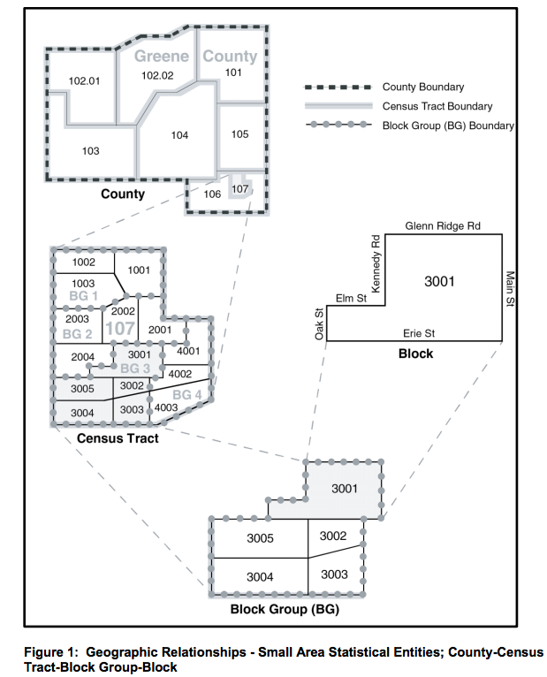
There is a one-to-one mapping between our districts’ locations and census blocks
13,284 Census blocks represented among our universe of 13,608 school districts
1.024 Districts per census block on average
6.94 Service providers to a block on average
Census Blocks are statistical areas bounded on all sides by visible features, such as streets, roads, streams, and railroad tracks, and by non-visible boundaries such as city, town, township, and county limits, and short line-of-sight extensions of streets and roads.
Notes:
64% of districts are meeting IA affordability targets.

Slide 4
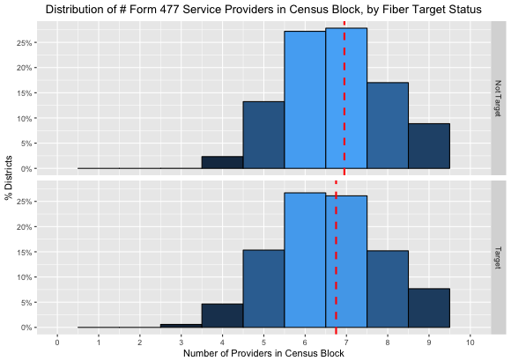
Fiber Targets are 2.2x as likely to have 4 service providers or less in their census block
Hypothesis: most of the Fiber Targets are in locations where there is only one or no service providers with speeds sufficient enough for 1 Mbps/student. Based on the distributions displayed here, this is disproven
Additional Finding: Fiber Targets have less service providers per census block on average than Not Fiber Targets¹
Fiber Targets are 2.2x as likely to have 4 service providers or less in their census block (5.2% vs. 2.3%)
15% Not Targets
<= 5 providers
2% Not Targets
<= 4 providers
20% Targets
<= 5 providers
5% Targets
<= 4 providers
¹and significantly less according to a one-sided t-test, p-value = 3.22e-06
3. Recommendations:
Since there are more service providers per Fiber Target census block than anticipated, we should further explore these providers and understand/quantify their ability to serve school districts
Due to the possibility of the Form 477 service provider list being inflated, this strengthens the impact of our additional finding

Slide 5
References
Form 477 Confluence Page
https://www2.census.gov/geo/pdfs/maps-data/data/tiger/tgrshp2016/TGRSHP2016_TechDoc.pdf

Slide 6
Appendix

Slide 7
Methodology
Considered all schools and districts in our universe of districts for this analysis
Census blocks were linked to schools and districts via latitude and longitude coordinates
Although it’s possible for schools and districts to lie on the boundary of multiple census blocks, none of the districts in our universe met this condition – i.e., each district was assigned to a unique block
Distinct service providers within the Form 477 data were identified via their ‘Holding Company Name’ (as filed on Form 477)
This was decided because there were the least amount of distinct Holding Company Names compared to other service provider name columns, and we want to be conservative and not overestimate the amount of service providers in a census block

Slide 8
Distribution of the number of service providers in a district’s census block by all Fiber Target Status’ (National Level)
Need to explore further why ‘Potential Targets’ seem to be the group with the most service providers per census block on average

Slide 9
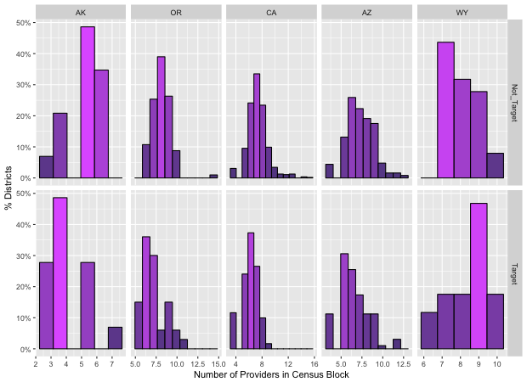
Distribution of the number of service providers in a district’s census block by Fiber Target Status – States with the largest differences, adjusted for % Fiber Target districts
Alaska, Oregon, California and Arizona are the states with the largest difference in distributions of # service providers, with Fiber Targets having less service providers per census block
In Wyoming, Fiber Targets actually have more service providers per census block

